Slide 1










Slide 2

Architect
Senior Engineer
Junior Engineer
BREADTH of Knowledge
Stuff you know
DEPTH of Knowledge
Stuff you know you don’t know
Stuff you don’t know you don’t know

Slide 3






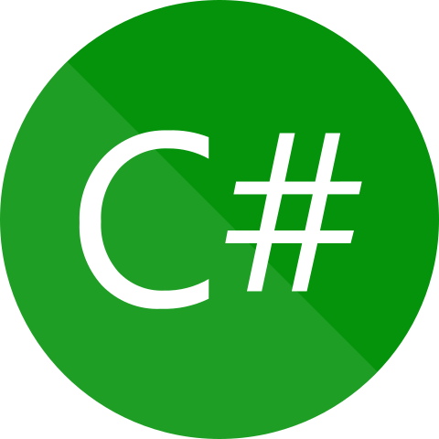




























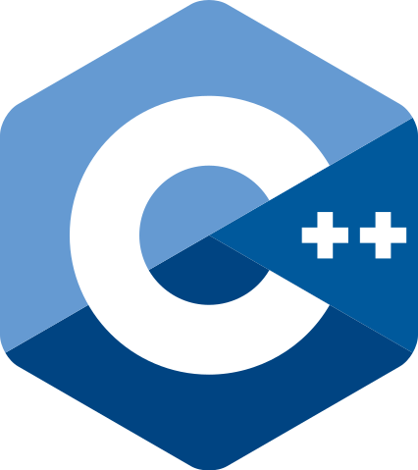



































Software Engineering
(the bits AI can’t replace)

Slide 4

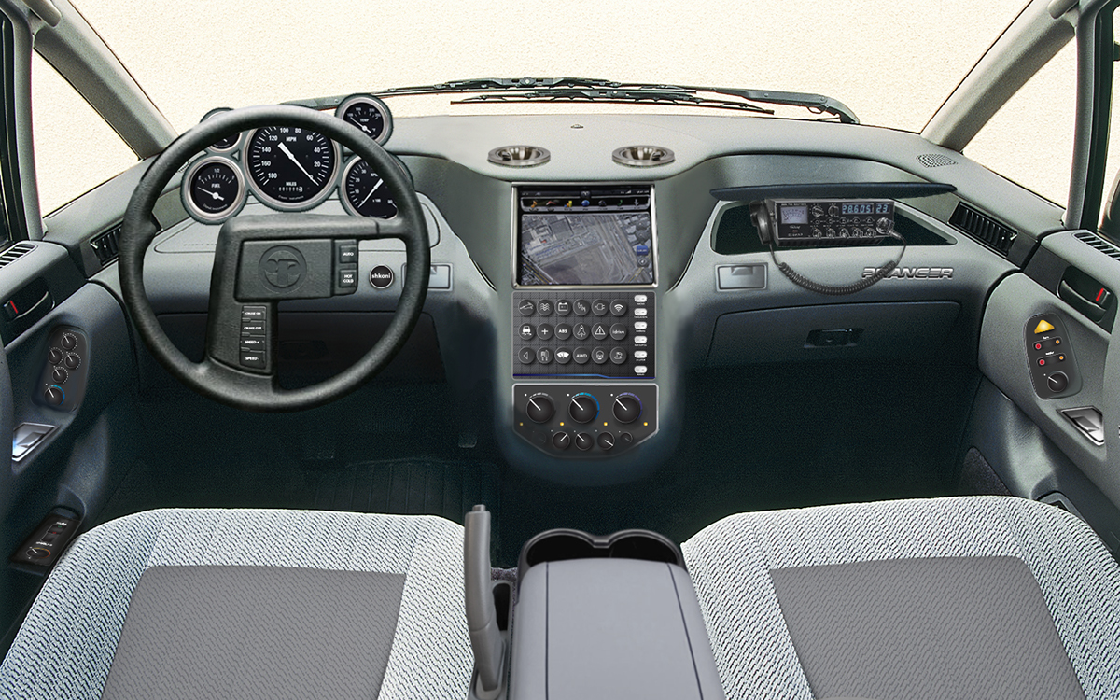


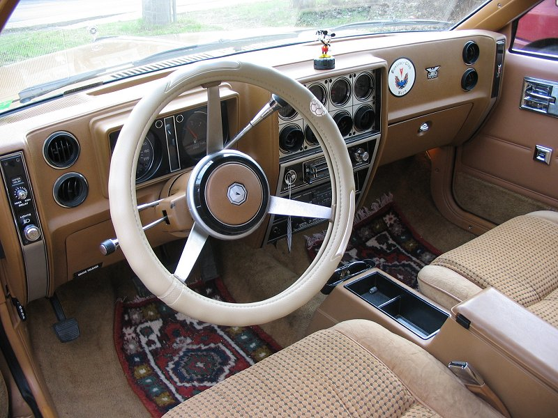
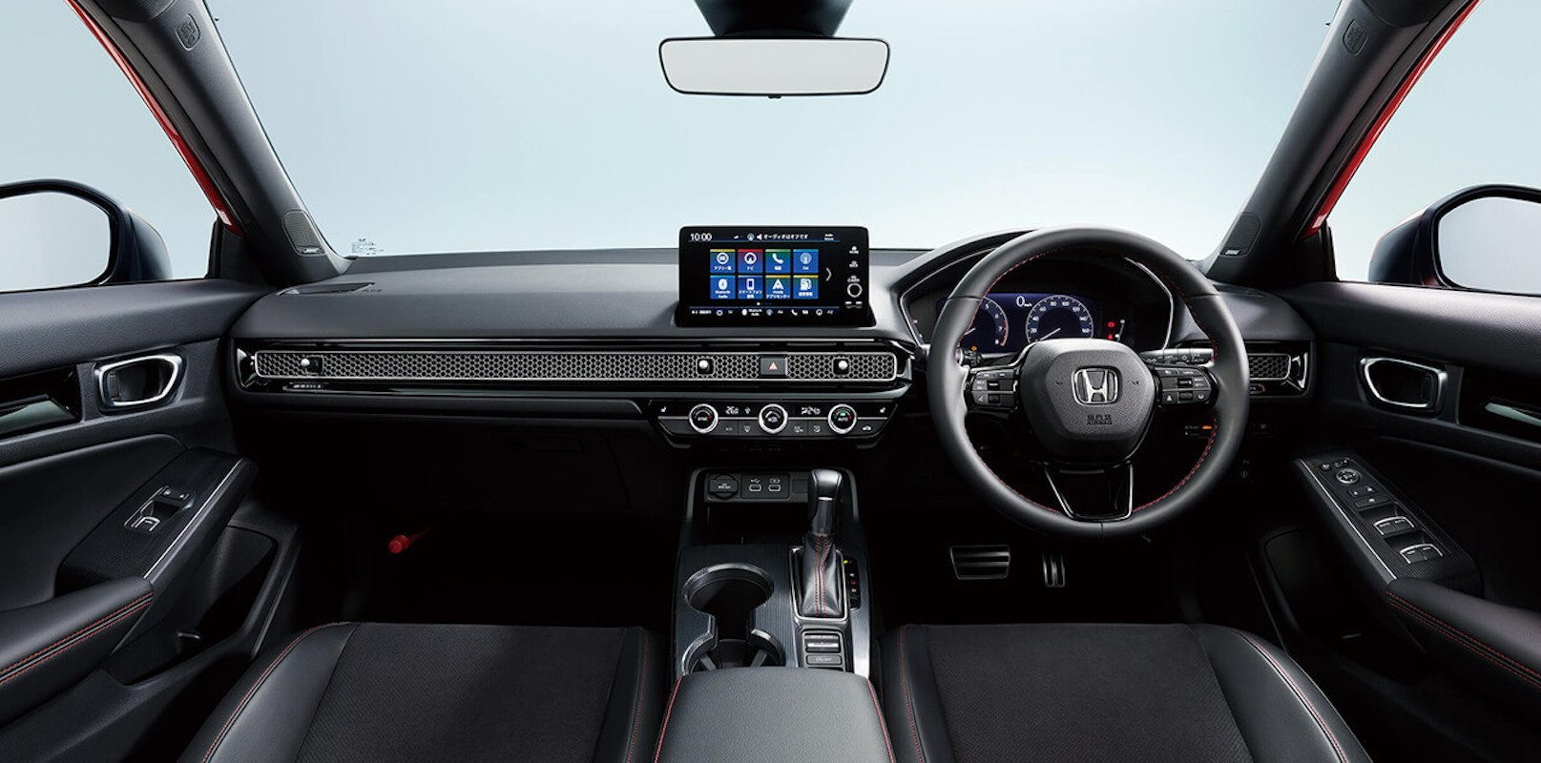
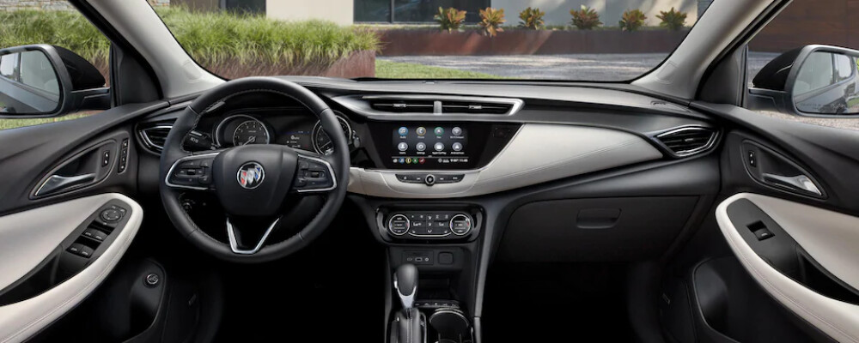
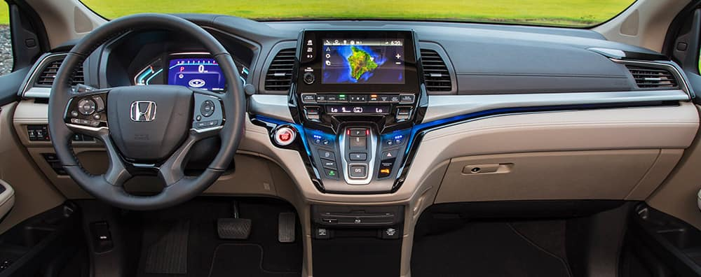

Slide 5

Core Skills
Analytical Thinking
Knowing how to learn (Growth mindset)
Creativity
Pragmatic thinking ?

Slide 6

Generative AI is going to steal your job!!!

Slide 7

The Full Stack
Fundamentals
Front-End development
Back-End development
Databases
Testing
Infrastructure
DevOps
Tooling
Design principles
User experience
Agile

Slide 8
Fundamentals
Languages / paradigms
Scripting
Object-oriented
Functional
Reactive
Clean coding
Abstraction
Modularity / reuse
Debugging

Slide 9
Technical
Principle
Pattern
Impl
Impl
Pattern
Impl
Impl

Slide 10
Modularity
Abstraction
Clean code
Implementation
Pattern
Principle

Slide 11
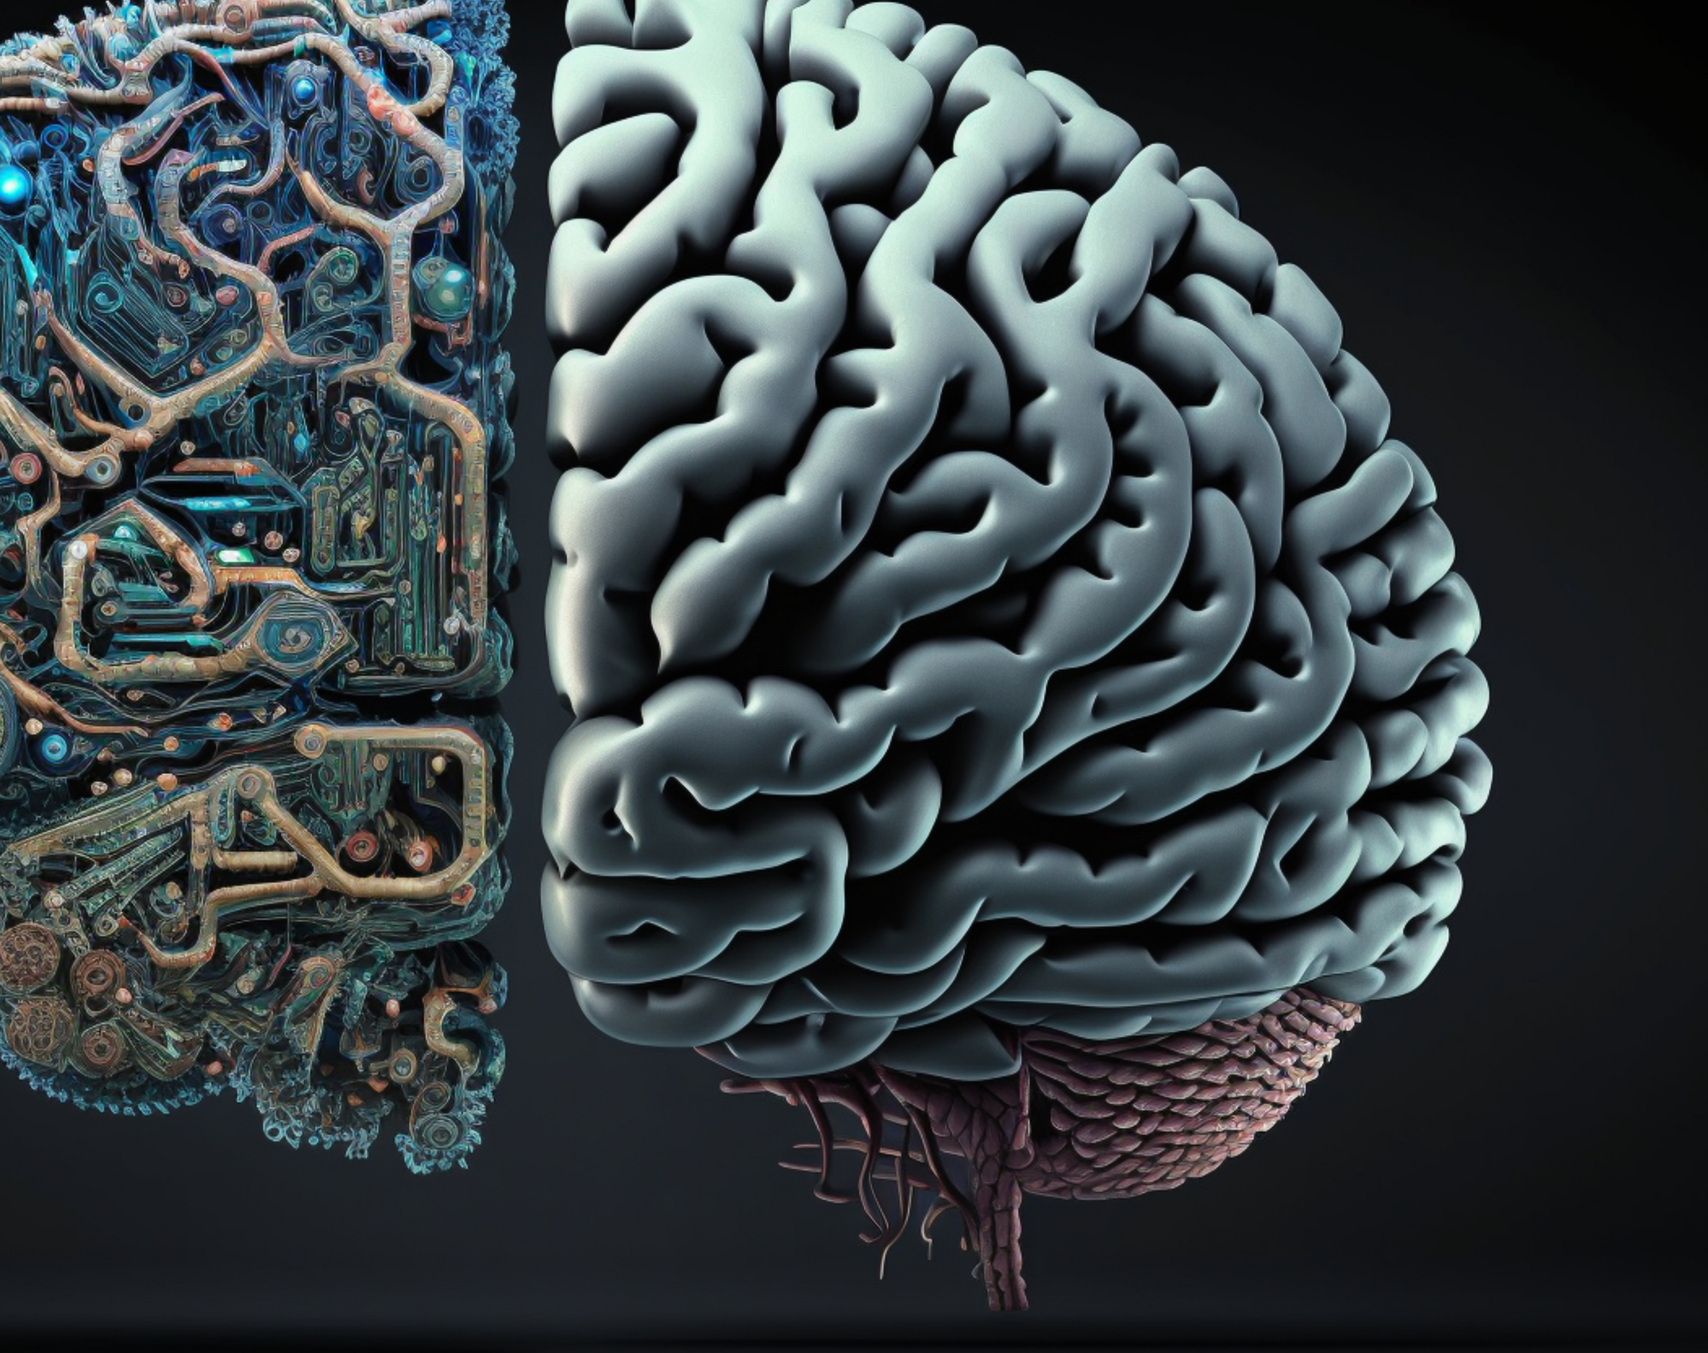
The Things AI Can’t Replace

Slide 12

Balance
ddd

Slide 13

Soft Skills

Slide 14

Growth Mindset

Slide 15


Slide 16

Attitude

Slide 17

Non-Functional Requirements
Scalability
Availability
Security
Usability
Maintainability
Reliability
Reusability
Testability
Observability

Slide 18

How to get promoted

